Slide 1

Data Enhancement of the DARPA SCORE Claims Dataset
Bhakti Dalvi
Pratik Mulye
Sagar Tanna
Bia 660 Spring 2020
Prof. Jordan Suchow

Slide 2
Project Objective
Generate the Ideas to create enhancement to the “DARPA” (Defense Advanced Research Projects Agency) claim dataset
Use of web mining techniques to implement those ideas
Determine and improve the credibility of Social and Behavioral Science Research results and claims

Slide 3
ENHANCEMENT IDEAS
Journal Ranking Computation Metrics
SJR (SCImago Journal Rank)
Uses Eigenvector Centrality Based Ranking
Thus, accounts for both the number of citations received and the importance of the Journal from which citation came from
H-Index (Hirsch index)
H-index is defined as the maximum value of h such that the given author/journal has published h papers that have each been cited at least h times
Computing The Ranking Of The Journals The Paper Was Published In
PROJECT FOCUS
Checking Whether References Used For A Particular Topic Have Ever Been Retracted

Slide 4
LIBRARIES USED AND APPROACH
Beautiful soup
Python library for pulling data out of HTML and XML files.
Provides idiomatic ways of navigating, searching, and modifying the parse tree
Other libraries
Pandas : For analyzing the score dataset
Requests: Accessing the Journal Links

Slide 5
ALGORITHM
Acquiring Unique Journal Names from the SCORES Dataset
Parsing the Individual Sites
Passing the Journal Names in the query string of the site https://www.scimagojr.com/journalrank.php
Acquiring the H-Index and SJR from the HTML content
Retrieving and Storing the Individual Journal Description sites
Exporting the acquired values to the SCORES dataset

Slide 6
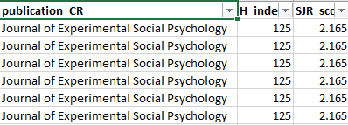

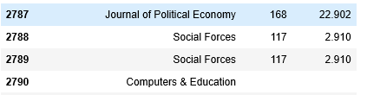
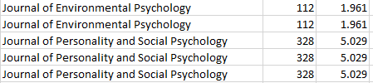
OUTPUT SNIPPET
Exported CSV Results and Python Output

Slide 7
ISSUES FACED
Finding a Reliable Web Source
Looking for a website which could provide relevant information for the journals in the dataset
Getting the DOI number of reference papers
Scraping References from papers
DOI for most of the papers was unavailable
Each paper had more than 50 references
Scraping around 150k references and employing directory looping for the same
Missing Values
Some Journals didn’t give any results for the search of the indexes

Slide 8
CONCLUSIONS AND FUTURE SCOPE
The code would be compatible even with further additions of papers from new Journals
The papers from the Journals having high H-index and high SJR could be given a reasonable amount of credibility and this weightage could be used in computing the reliability score
Future modifications could involve building robust algorithms for scraping the references and finding sites for accessing the DOI

Slide 9
THANK YOU!

